Slide 1
Directed Graph using Adjacency Matrix
CSE106
Execution time and Time Complexity Explained
Group - 01
Akmal Hossain (2019-3-60-123)
MD Ekramul Haque Khan (2019-3-60-080)
Mahjabeen Chowdhury (2019-3-60-006)

Slide 2
Code Explanation
and
Program Demonstration

Slide 3
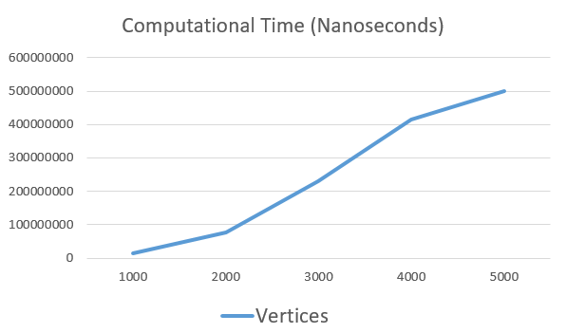
Time Complexity from Graph
Computational Time vs Number of Vertices
The graph drawn from the Computational time taken from the program gives a -
Linear Graph
We know that, O(n ²) time complexity gives a Linear graph.
Therefore, the approximate time complexity of the program is O(n ²).

Slide 4
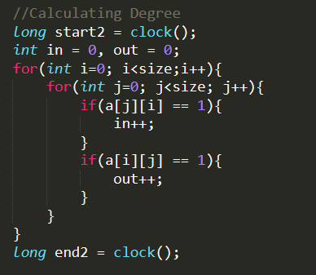
Theoretical Time Complexity
The calculation of degree uses a Nested loop and it does
2 condition checks inside the loop. So the total is,
f(n) = n (3n+1) + 1
= 3n ² + n + 1
now, when n > 1 ,
0 ≤ 3n ² + n + 1 ≤ 3n ² + n ² + n ²
= 5n ²
therefore, f(n) = 3n ² + n + 1 = O(n ²)
Also, 3n ² + n + 1 ≥ 3n ²
therefore, f(n) = 3n ² + n + 1 = Ω(n ²)
So, The time complexity is , f(x) = θ(n ²)

Slide 5
Conclusion
From the graph of Computational time, we can see that the Time Complexity of the Program is approximately O(n ²).
From the Theoretical calculations we also obtained the average case Time Complexity is θ(n ²).
Since, Approximate time complexity = Theoreical time complexity
We can come to a conclusuion that the Computation of In-Degrees and Out-Degrees of a Directional Graph using Adjacency Matrix runs on a Time Complexity of O(n ²).

